Slide 1

RFID (CENTOS)
Malaysia | Singapore | China | Vietnam | Indonesia | Philippines | Sri Lanka | Thailand

Slide 2

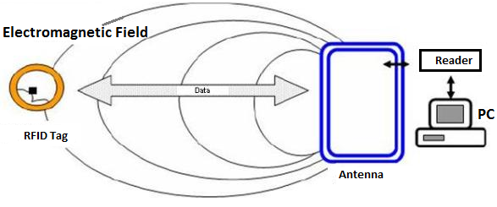
What is RFID? (Radio Frequency Identification)
A technique facilitating identification of any product or item without the requirement of any line of sight amid transponder and reader.
Notes:
RFID Structure
1. TRANSPONDER which is located on the product to be scanned
2. READER @ read & write device
- INCLUDE radio frequency module, a controlling unit for configurations, a monitor and an antenna to investigate the RFID tags.
- In-built with an extra INTERFACE allowing them to forward the data received to another system (control system or PC).
3. RFID TAG – The actual data carrying tool of an RFID structure, got antenna & electronic micro-chip.

Slide 3
RFID Applications
Asset tracking
Inventory management
Controlling access to confined areas
Personnel tracking
Supply chain management
ID badging
Record the time when lorry pass by the gate.

Slide 4
RFID(CENTOS)
OPERATING SYSTEM | CENTOS
DATABASE | MARIA DB
COBOL COMPILER | ISCOBOL + CTREE RTG INDEXED DB
COBOL DATA BRIDGE | ISCOBOL DATA BRIDGE
RFID PROGRAMMING | JAVA OR C
FILE SYSTEM | /RD
FOLDER | /RD/p01/
RFID PRINTER | RFID PRINTER + RFID TAG
RFID READER | FIXED READER + ANTENNA WITH LAN
RFID MOBILE READER | MOBILE READER WITH WIFI

Slide 5
DEVELOPMENT PROGRESS
STEP | DUE DATE | TASK | STATUS
01 | 16/10 | SETUP SERVER + DB | DONE
02 | 21/10 | SETUP COBOL COMPILER + DATABASE | 15%
03 | 30/10 | DEVELEOP COBOL PROGRAMMING PART 1 | 55%
04 | 08/11 | DEVELOP COBOL PROGRAMMING PART 2 | -
05 | 19/11 | DEVELOP JAVA OR C PART 3 | -
06 | 28/11 | DEVELOP JAVA OR C PART 4 | -
07 | 05/12 | FINAL PRESENTATION | -

Slide 6
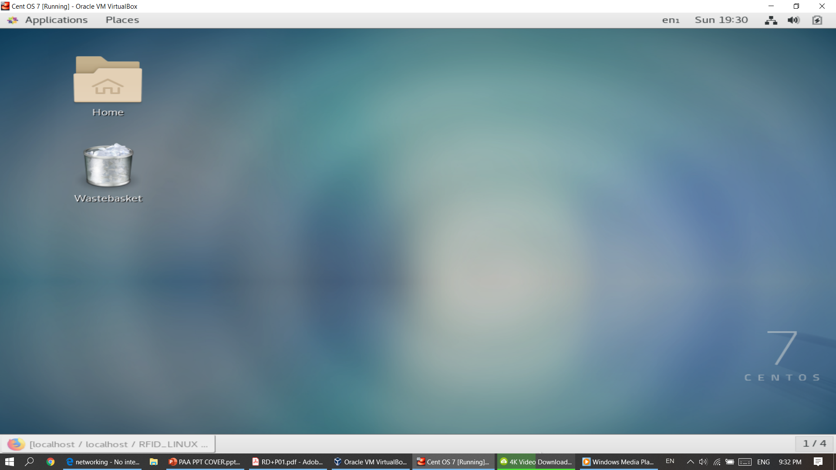
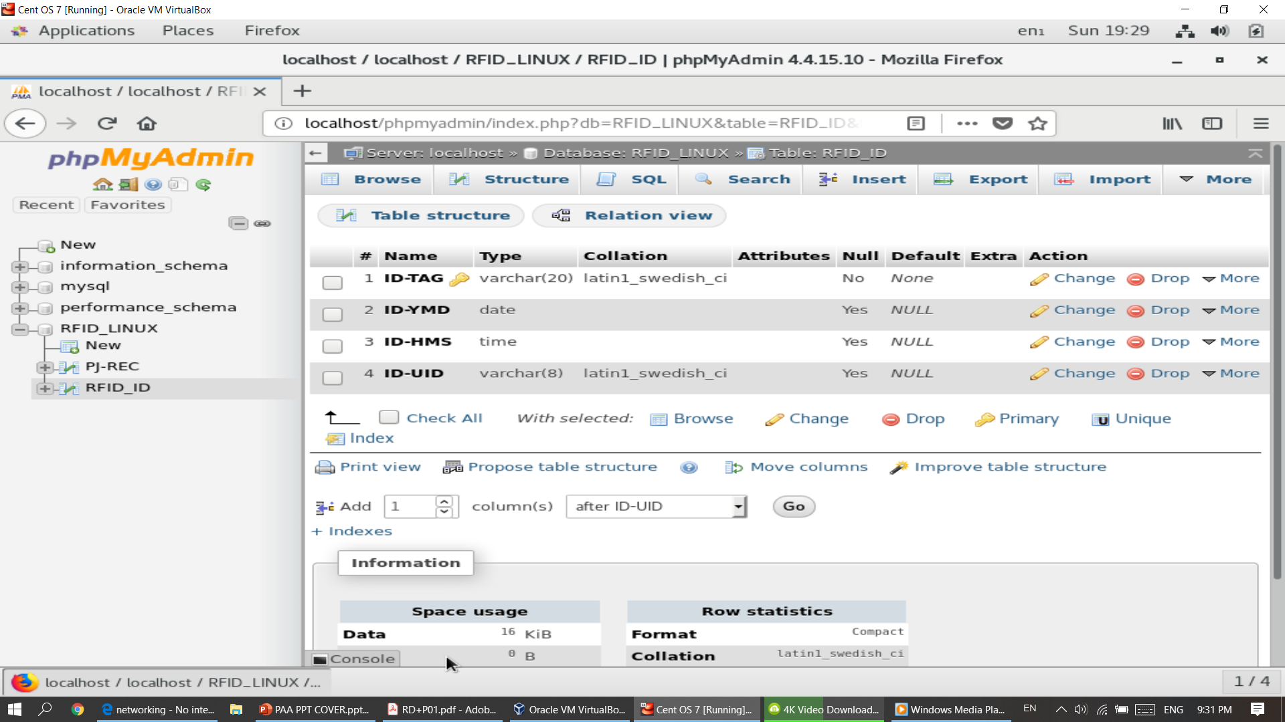
STEP 1: SETUP CENTOS & MARIA DB

Slide 7
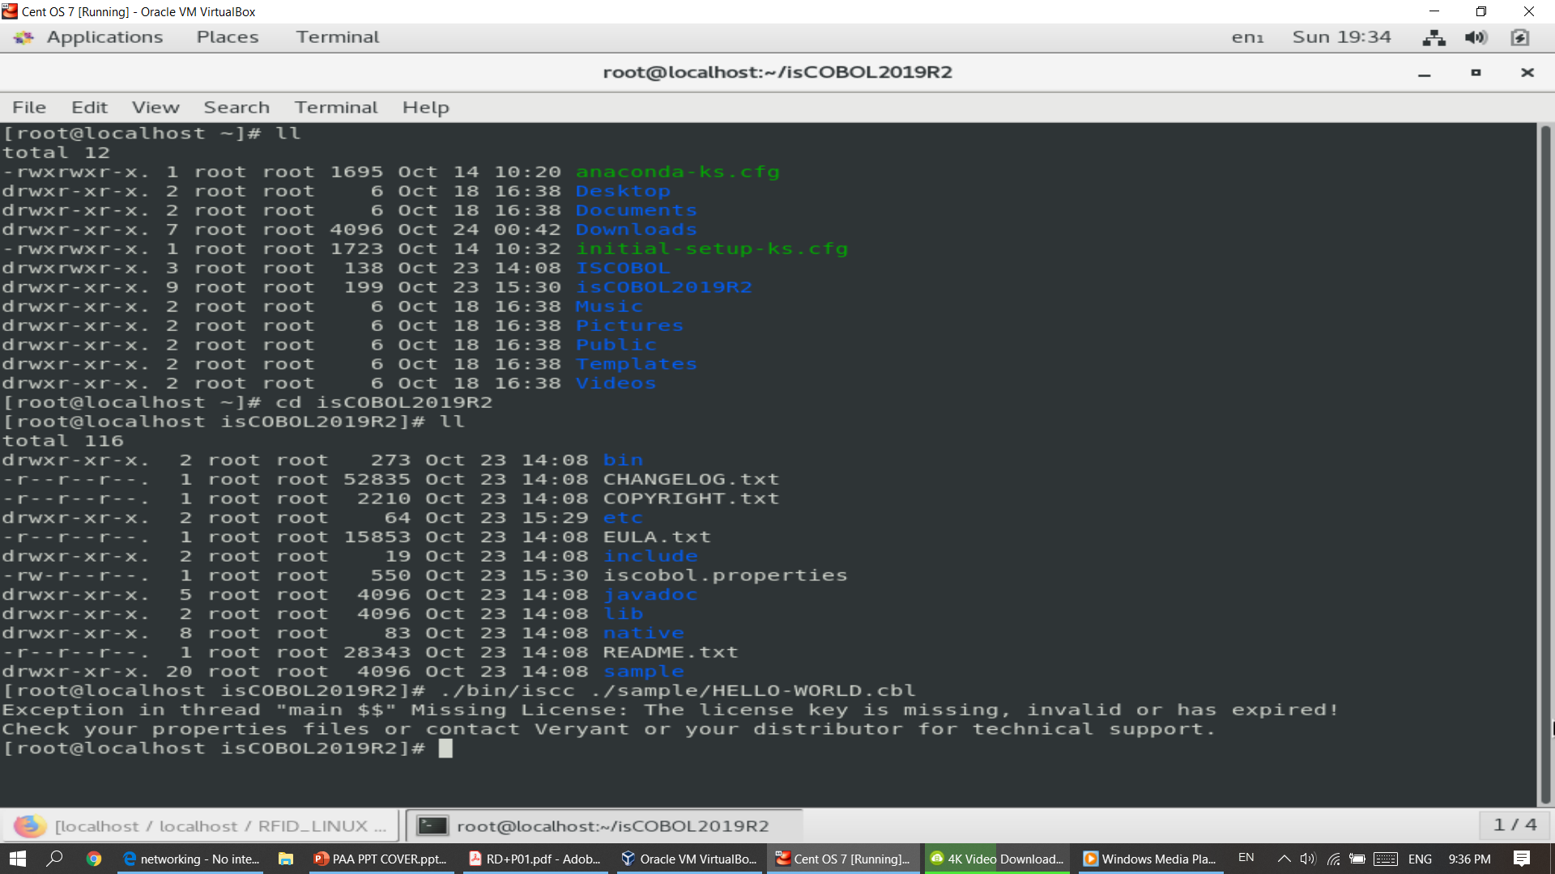
STEP 2: SETUP ISCOBOL & INDEXED DB

Slide 8
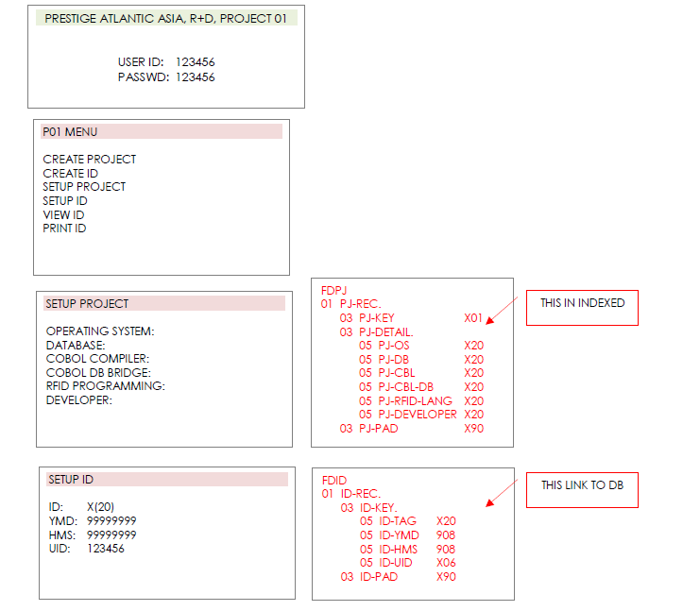
STEP 3: DEVELEOP COBOL PROGRAM(PART 1)

Slide 9
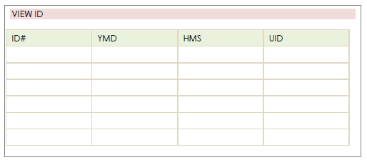
STEP 3: DEVELEOP COBOL PROGRAM(PART 1)

Slide 10
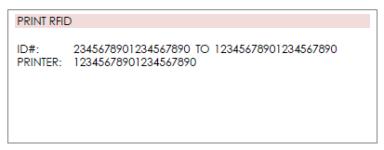
STEP 3: DEVELEOP COBOL PROGRAM(PART 1)

Slide 11
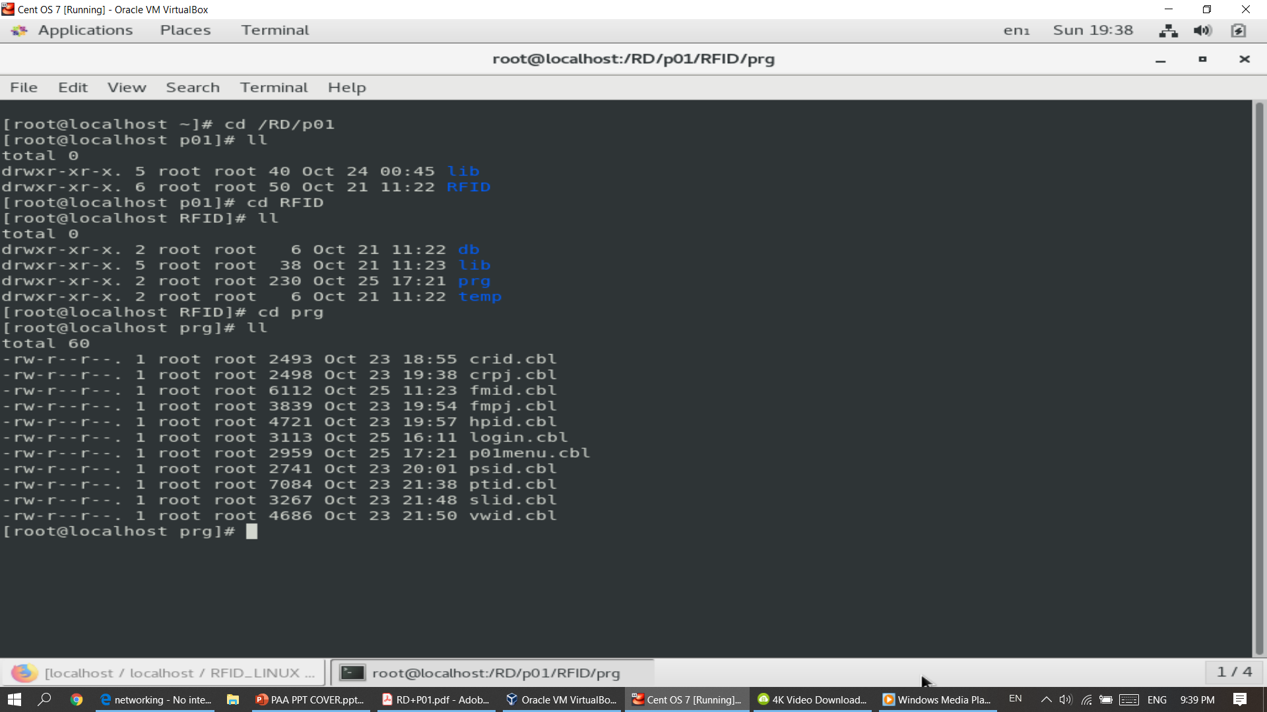
STEP 3: DEVELEOP COBOL PROGRAM(PART 1)

Slide 12
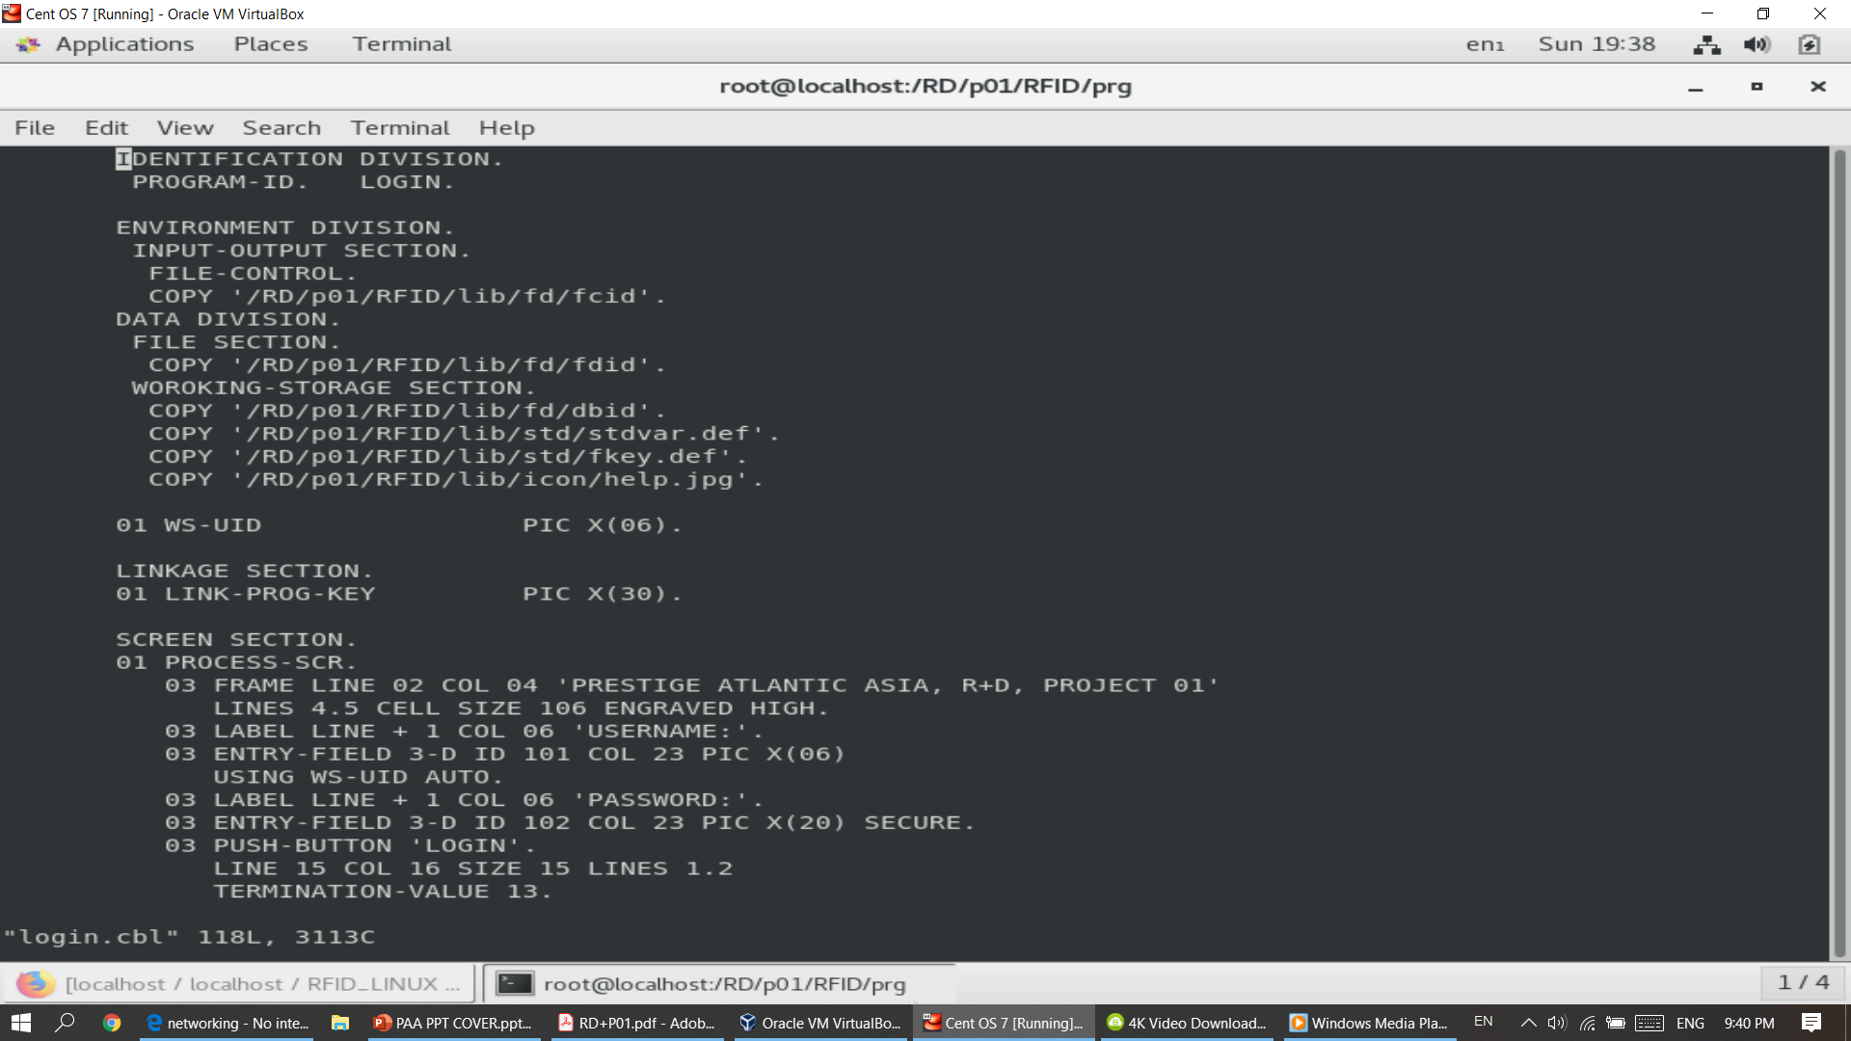

Slide 13
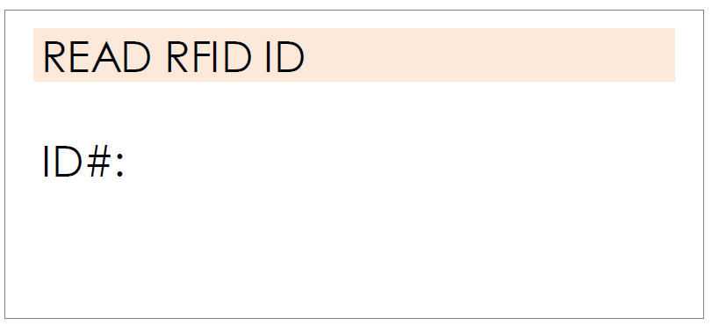

STEP 4: DEVELEOP COBOL PROGRAM(PART 2)
DEVELOP THIS TELNET + TEXT PROGRAM AND DATA UPDATE TO ID.DB

Slide 14

STEP 5: DEVELEOP JAVA/C PROGRAM(PART 1)
DEVELOP JAVA OR C PROGRAM TO READ RFID ID TAG USING FIXED READER WITH MULTIPLE READ + UPDATE ID.DB

Slide 15

STEP 6: DEVELEOP JAVA/C PROGRAM(PART 2)
DEVELOP JAVA OR C PROGRAM TO READ RFID ID TAG USING FIXED READER WITH SINGLE READ LIKE TOUCH-N-GO + UPDATE ID.DB

Slide 16

Thank You
VAN TZE SHAN

